Slide 1
Committee Meeting #1
Timelines, Research Objectives, and Committee Expectations

Slide 2
Agenda Items
Broad overview of my research interests
Timelines
Committee Expectations
Deep-dive of each chapter objective
Chapter 1
Chapter 2
Chapter 3

Slide 3
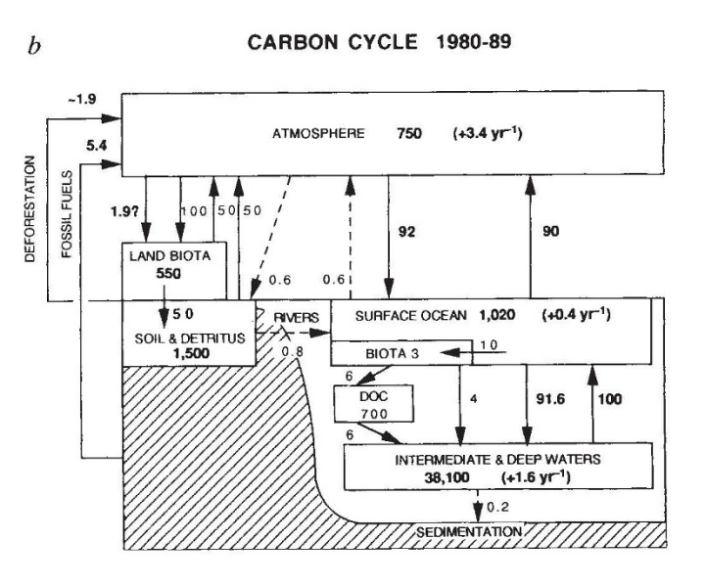
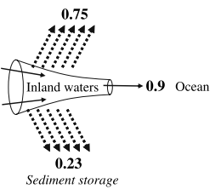
Siegenthaler & Sarmiento, 1993
Notes:
Active pipe concept and wetlands are carbon pumps to streams
I’m sure most of the you already know this but to orientate everyone

Slide 4
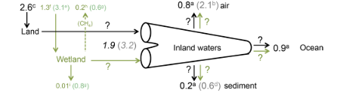
Cole et al. 2007
Abril and Borges 2019

Slide 5
Still huge knowledge gaps. Knowledge gaps I can help close are
Agenda Item 1: Broad Overview

Slide 6
Outline of my chapters

Slide 7
Overarching objective

Slide 8
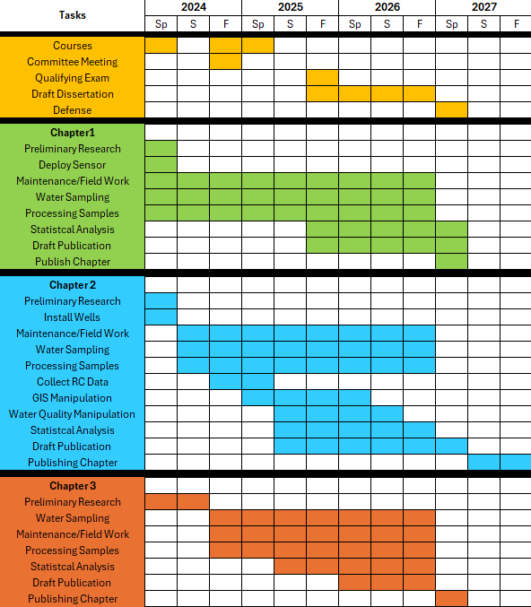
Notes:
Since Amanda must leave in a few for the PEERs seminar, I was advised to invert this meeting and start with my timelines. This task list is identical to the proposal. I started my PhD officially this past spring but began deploying sensors.
Chapter 1 is very much underway. We have about a year’s worth of sensors readings and 6 months of water sampling. I am beginning to work the data into something meaningful
Chapter 2 is also ongoing. I’ve deployed wells within the river corridor but would like to deploy one well per sites in the uplands. For these field days, I am still working on perfecting methodologies especially when it comes to gas sampling, but I have about 5 months of water sampling
Chapter 3 is ad hoc. When there has been a lot of rain, I go out to sample. Sampling sites have been selected and I have had three sampling events, two which as usable.
So, all in all, I would say I am on track!

Slide 9
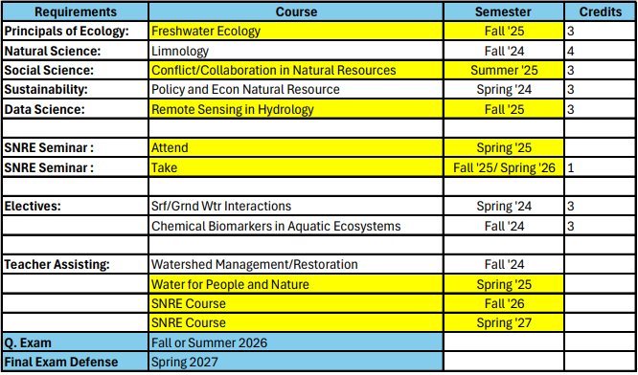
Agenda Item #2: Timelines
Notes:
As for my classes, I wish I was more along. For SNRE, I’ve completed 2 of the 5 course requirements. I am not taking courses next semester but will be taking a course this summer and two in the Fall to round out my requirements.
I would like to try and earn the hydrology concentration the water institute offers but 1) I detest homework and 2) I’ve been here forever and there are very few hydrology courses I haven’t between undergrad and now. So, its not really a priority unless you would like it be
SO, all that said, I would like to aim for Q Exam either Fall or Summer 2026- so a year from now, and defend early, early spring 2027. Like materials completed before the Fall semester ends.

Slide 10
Committee Expectations
How often should I meet individually with each of you?
How often should we all meet?
Are any aspects of the project you would like to be more involved in?
Concerns and questions?

